Slide 1



Preparation of the Study plan as part of the Erasmus+ Program:
Key steps, deadlines and useful contacts
Erasmus+ call for application 2022-23

Slide 2
Before the departure (1/2)
The destinations are assigned according to the rankings (via the GOMP system)
Preparation of the learning agreement (LA) with the help of Erasmus+ support teachers:
  Engineering : Prof. Mauro Scungio mauro.scungio@unitus.it
  ECA (VT): Prof. Patrizio Morganti morganti@unitus.it
  AFC & MKQ: Prof.ssa A.M. D’Arcangelis adarcangelis@unitus.it
  SPRI & LM62: Prof.ssa Barbara Pancino bpancino@unitus.it
  Civitavecchia center (ECA & E.Circolare): Prof. Riccardo Cimini rcimini@unitus.it
  Finance students (curricula di ECA e AFC): Prof.ssa D’Arcangelis adarcangelis@unitus.it
The LA document consist in:
  List of courses you want to attend
  Approval plan (correspondence with exams in Viterbo)

Slide 3
Activities allowed at the foreign University
The activities allowed during your mobility, to be specified in your Learning Agreement, may consist of:
Educational activities (courses) and relative assessments tests (exams);
preparation of thesis;
traineeship (only if allowed by the academic rules).
PhD students must agree on the educational path to be taken abroad with their PhD coordinators.

Slide 4
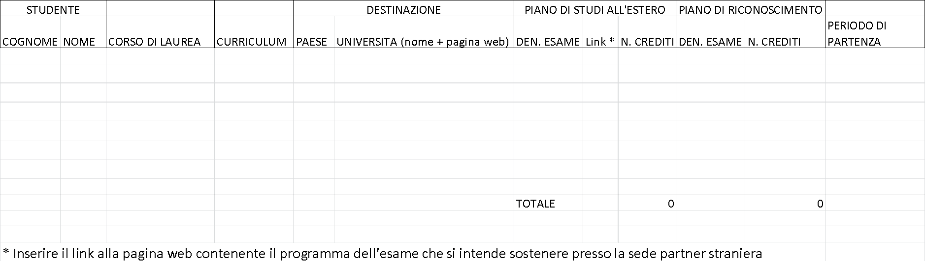
Learning Agreement (LA)
Students have to draft an Excel file with the help of their course’s support teacher in order to obtain prior approval
In the DEIM website (‘International’ section)
http://www.unitus.it/it/dipartimento/deim/internazionalizzazione-deim/articolo/sportello-internazionale-deim you will find:
A) An Excel File
B) LA examples, sorted by destination

Slide 5
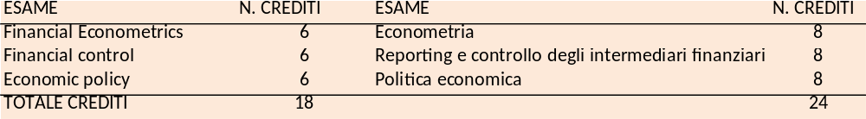
Criteria
Correspondence of the title and content of the course (program comparison)
Pay attention to:
  teaching semester
  language of the courses
  level (bachelor/master)
  The total number of credits must correspond both in the study plan abroad and in that of approval, with a tolerance of 2 ECTS per exam
  For example:

Slide 6
Before the departure (2/2)
3. After having obtained a prior approval of your Study Plan (in Excel format) from your course’s support teacher, the LA has to be filled out and signed in the GOMP system
[for more information, you may contact the international office at the email address erasmus@unitus.it]
4. Once the LA is signed by the Erasmus+ DEIM Coordinator (Prof. Branca), it is sent to the DEIM Academic Office for a definitive approval by the Department. After that, the LA is sent to your host University.
5. You’re ready for departure! (I or II semester 2022/23)

Slide 7
About your CFUs
The recognition of CFUs takes place according to the LA. The Department may only recognise the CFUs that are stated in your Transcripts of Records.
You are allowed to not carry out all of the activities planned in your LA, as long as you obtain at least 12 credits.
Students who have not earned the pre-planned credits must all the same submit a statement issued by the host institution attesting their participation in the teaching activities.
In the case of a mobility for internship purposes that is not required by the student’s course of study, the University supervises this activity (certified by the host institution) in the Diploma Supplement.

Slide 8
Pre-departure Deadlines
Allocation of destinations according to rankings
Preparation of the Learning Agreement (LA) in accordance with your course’s support teacher (no later than 31/5/22)
Drafting of the LA on the GOMP system (no later than 31/5/22)
Approval of the LA by the DEIM Department council (June-July 2022)

Slide 9
After the departure
Contact Dr.ssa Felicetta Ripa (erasmus@unitus.it)
Register for the courses you planned for in your LA and check if they will be actually taking place
In case of changes to be made to the LA (LA Change):
  Contact your course’s support teacher via email
  Discuss the changes to both the list of exams and the approval plan with your support teacher. Fill the LA Change in the GOMP section and ask for Prof. Branca’s signature – branca@unitus.it
  The LA Change will later be formally approved by the department council.
  Always keep Dr. Felicetta Ripa updated on the various steps of your mobility (departure, arrival, Changes, etc.) !

Slide 10
Additional information
University guidelines for the Erasmus programme
http://www.unitus.it/it/unitus/normativa/articolo/normativa-regolamenti-per-studenti-e-post-lauream-
DEIM website (‘International’ section):
http://www.unitus.it/it/dipartimento/deim/internazionalizzazione-deim/articolo/sportello-internazionale-deim
DEIM Facebook page
https://www.facebook.com/DipartimentoEconomia.Unitus

Slide 11
Useful contacts
International office (S.M. Gradi):
  Dr.ssa Felicetta Ripa (erasmus@unitus.it)
DEIM Erasmus+ support teachers:
  Prof. Mauro Scungio (Engineering) mauro.scungio@unitus.it
  Prof.ssa AnnaMaria D’Arcangelis (AFC & MKQ) adarcangelis@unitus.it
  Prof. Riccardo Cimini (ECA & E.Circolare Civitavecchia) rcimini@unitus.it
  Prof. Patrizio Morganti (ECA, Viterbo) morganti@unitus.it
  Prof.ssa Barbara Pancino (SPRI) bpancino@unitus.it
DEIM Academic Offices:
  ECA, AFC & MKQ (Viterbo): Dr.sse Primieri e Bruzzichini (didatticaeconomia@unitus.it )
  SPRI: Dr.ssa Moscetti (moscetti@unitus.it )
  Engineering: Sig.ra Filippetti (filippetti@unitus.it )
  Courses held in Civitavecchia: Sig.ra Paola Giganti (paolagi@unitus.it )
Erasmus DEIM office (erasmus.deim@unitus.it)
Erasmus+ Department contact person:
  Prof. Giacomo Branca (branca@unitus.it)

Slide 12
About language proficiency
Check with the utmost care the language requirements issued by your host University → MOST UNIVERSITIES REQUIRE LEVEL B1 of their national language(s) WHICH CAN BE CERTIFIED IN THE FOLLOWING WAYS:
certification by an accredited institution (ex. Cambridge/IELTS certifications);
have obtained a Language Passport (level B1) from the University Language Services Unit;
have passed a curricular language exam present in your study course, or have obtained (either at the University Language Services Unit or through your study course) a linguistic proficiency level of at least B1
be a native speaker of the destination country (or the host university’s vehicular language);
be in possession of a high school diploma stating that your studies were carried out in the language of the destination country (or in the host University’s vehicular language).
To book language placement exams at DISTU: ferrante@unitus.it
Language Services Unit : http://www.unitus.it/it/dipartimento/unita-servizi-linguistici

